Slide 1
Digital technologies – Platform and Architecture

Slide 2
TOC
Overview of technology architecture
Platform
Client
Server

Slide 3
Components of Architecture
Platform = Hardware + basic software required to run the computer.
Clients (with access to internet)
OS
Browser
Server
OS
Web server
Application servers
Back-end transactional software
(includes TP monitors, database management system and DW).
Operating Systems
Servers: Unix, non-Unix, Linux, Windows NT/2000/XP/Vista/7/8/10
Client
PC: Windows, Mac OS
Portables: iOS, Android, Windows Mobile

Slide 4
Components of Architecture
Communication infrastructure
Internet
Routing devices at the boundary of the enterprise.
Security devices

Slide 5

















Client-server architecture
server:
always-on host
permanent IP address
data centers for scaling
clients:
communicate with server
may be intermittently connected
may have dynamic IP addresses
do not communicate directly with each other
client
request/reply
server

Slide 6
P2P architecture
no always-on server
arbitrary end systems directly communicate
peers request service from other peers, provide service in return to other peers
self scalability – new peers bring new service capacity, as well as new service demands
peers are intermittently connected and change IP addresses
complex management
peer-peer

Slide 7
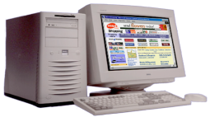
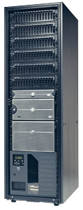

Client-Server architecture
2 tier client-server architecture
Tiers
the # of elements into which the application is partitioned
the # of platforms where the executables are deployed
Web & Application
clients
Comm.
network
(Internet /
Private Network)
Database-server
Database
“fat client”
TIER 1:
Client-Tier
TIER 2:
Server-Tier

Slide 8
Client-Server architecture
fat client
Send a request
Receive a request
Data
Pro- cess- ing
Pro- cess- ing
Data
Comm.
network
Receive a response
Send a response
Client Computer
Server Computer

Slide 9
Client-Server architecture
2 tier client-server architecture
TIER 1:
Thin Client
TIER 2:
Server
One central server performs
all processing
Comm.
network
Database
Notes:
thin client 는 저장장치가없고
모든 저장장치는 서버가한다.

Slide 10
Client Considerations
How much application logic by the client?
Thin client, server handles most logic
Pros: security, easier maintenance
Cons: less control for users, higher cost for larger servers (Scalability problems: server capacity)
, diminishes sharing load between clients and servers
Fat client, logic handled by client
Pros
Usability: Windows GUI
Easy to modify: follow open standards
Scalability: easy to add clients up to server capacity
Cons
Increase in complexity: multiple standards coexist
Limited interoperability
Difficult to identify the cause of an error: multiple suppliers
Private stored procedures
High-maintenance costs: re-install into multiple clients
Poor business logic sharing
Notes:
thin , fat 장단점
장점;thin 서버가 모든 프로세스를 담당함, 유지보수가 편함( 서버만 손대면됨, 클라이언트 부분은 손대지 않아도됌)
단점; 자기 맘대로 할수있는게 없다, 서버의 용량이 많이 필요함(서버의 가격이 그만큼 비쌈,비용) Scalability :용량의 확장이 비쌈
fat장점:공개표준 수정이 쉽다.(표준을 정해놓고 시작하기때문), 확장성이 용이함
fat단점 : 복잡성 증가, 상호운용성이 낮아짐,오류가 발생했을때 발견하기 힘듬, 단말기오류인지 통신망의오류인지 서버오류인지(서버가 여러개있음)알기힘들다.
애플리케이션은 크게 3부분으로 나뉨 UI, Business logic, data logic

Slide 11
Client-Server architecture
Internet computing architecture
Clients
Servers
Client makes requests
Internet
Server responds
High Quality of Data
Access From Anywhere

Slide 12
Client-Server architecture
2-tier web architecture
Web client(Web Browser)
HTTP
Internet
web server
HTML files
Notes:
모든 웹페이지는 http프로토콜을 이용해서 소통한다 (클라이언트-서버)

Slide 13
Client-Server architecture
2-tier web architecture
Web client
HTTP
Internet
web server + processing program
Data
Notes:
웹페이지의 내용이 일정하지않고 고도화돼서 업데이트를 진행한다. 접속 시점,접속대상자에 따라 내용을 다이나믹하게 만듬.
다이나믹한 내용및 데이터를 보내려면 프로그램이 필요하다.

Slide 14
Changes in IT architecture
3-tier web architecture
Web client
HTTP
DB Server
Internet
web server
Application server
DB
Notes:
Separating the database from a web server provides additional security 웹 서버에서 데이터베이스를 분리하는 추가 보안을 제공한다.
웹서버인 동시에 애플리케이션 서버의 역할을 한다.

Slide 15
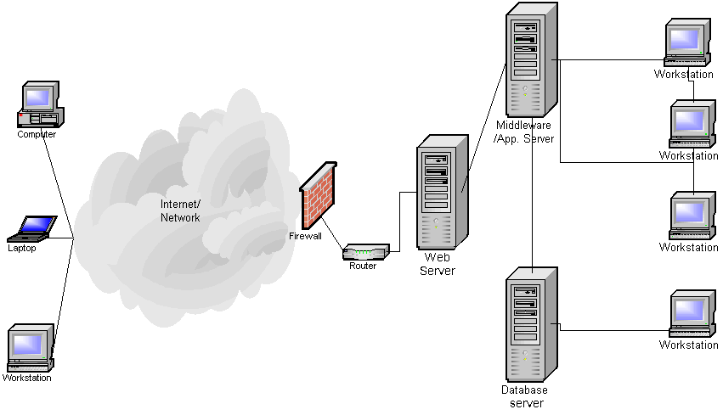
Complex e-business architecture
Coded for
specific
application
Web client
Optimized for
web page
delivery
HTTP
Managed and
tuned by DBA
DB
Notes:
굳이 따진다면 이것은 4티어 그냥 n티어로 부름
미들웨어는 웹소프트웨어와 데이터베이스소프트웨어의 가운데에 있는것. 두가지 소프트웨어 사이에 있으면 다 미들 웨어라는 명칭을 씀
더 복잡하면 어플리케이션서버를 또 분리 시킨다. (다음장)

Slide 16
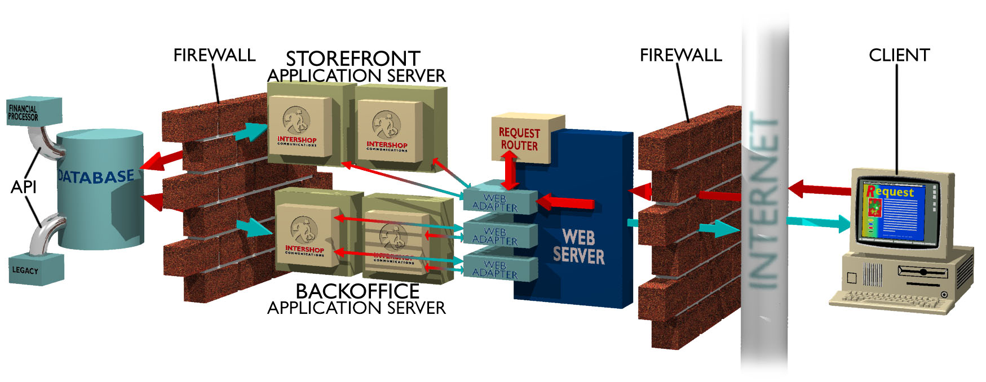
Complex e-business architecture
InterShop

Slide 17
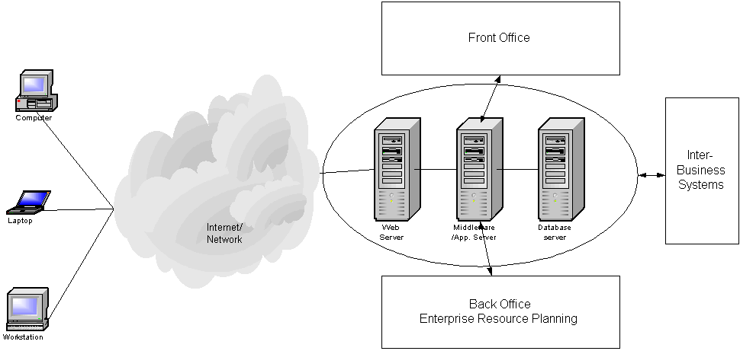
Integrated e-business

Slide 18
Browser statistics
1995 ~ 2008 IE dominant
2022 | Chrome | Edge | Firefox | Safari | Opera
August | 81.1 % | 7.6 % | 5.2 % | 3.4 % | 1.7 %
July | 81.1 % | 7.5 % | 5.0 % | 3.4 % | 2.1 %
June | 76.3 % | 7.4 % | 5.1 % | 3.6 % | 2.3 %
May | 79.9 % | 7.3 % | 5.3 % | 3.8 % | 2.4 %
April | 80.3 % | 7.2 % | 5.3 % | 3.8 % | 2.4 %
March | 80.3 % | 7.5 % | 5.3 % | 3.7 % | 2.3 %
February | 79.9 % | 7.5 % | 5.4 % | 4.0 % | 2.3 %
January | 80.1 % | 7.3 % | 5.5 % | 3.9 % | 2.3 %
http://www.w3schools.com/browsers/browsers_stats.asp
Notes:
ㄴ9/20

Slide 19
Server Configurations
Sizing a Web Server
User demand or volume
Hits per second/ average versus peak
Other functions: authentication, transfer protocol information, managing connections (sockets)
Type of content
Text takes less space than images (and less time to transfer)
Script requests
Network Bandwidth
Thin server
Designed for one function
Server farms and server collections
Allows clustering
Fault-tolerant systems
Middleware, operating system clustering software, and custom applications for seamless clustering
Load balancing
Server failover
Data mirroring

Slide 20
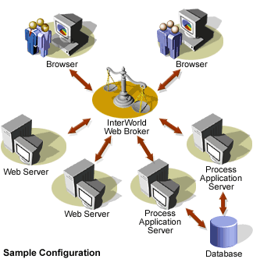
Web Broker Architecture
FEATURES
• More distributed than InterShop
• Broker acts as distribution agent
SOURCE: INTERWORLD

Slide 21
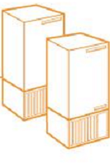
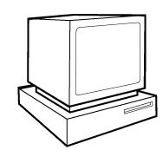
Server Accelerators (Surrogates)
Origin
Server
requests to
origin server
all content
requests for
the origin server
Server Accelerator (surrogate)
maintains cache of
frequently accessed
web pages
Client A
Client B
SOURCE: G. TOMLINSON

Slide 22
Server Cluster (Server Farms)
To serve many clients, one server is not enough
How do multiple servers cooperate?
Router
Network Switch
Network Switch
Router
Intranet Firewall
Internet Firewall
Web Servers
DB Servers
App Servers
HTTP request
Server farm
HTTP request
SOURCE: ATESTO

Slide 23
Server Clusters (Farms)
Origin
Server A
Origin
Server B
Origin
Server C
Origin
Server n
Request-
Router
Surrogate
Surrogate
Surrogate
2
1.
Client’s content request.
3
1
2.
Response indicates best
surrogate.
Client
3.
Client connects to best
Surrogate for content.
SOURCE: G. TOMLINSON

Slide 24
Server Selection Problem
Server Farm A
Server Farm B
Which server?
Which network site?
Avoid scalability problems of central servers by distributing load
“Contact the weather service.”
SOURCE: JEFF CHASE

Slide 25
URL-Based Load Balancing
Substring matching for:
“images”
“.gif”
“.jpg”
Load distributed within group via any standard metric or URL hashing
GET /www.foo.com/images/abc.gif
GET/www.foo.com/event/reg.bin
Substring matching for:
“.cgi”
“.bin”
“.exe”
GET /www.foo.com/product/abc.html
Substring matching for:
“.html”
Servers optimized for specific content-types
Substring match on URL directs HTTP requests to designated server farm
Load balancing using configured algorithm or,
URL Hashing forwards requests for each unique URL to same server to take advantage of server memory caching
SOURCE: SUN

Slide 26
DNS Round Robin Balancing
SERVER
a
b
c
d
DNS server for
nhc.noaa.gov
“www.nhc.noaa.gov is
IP address a”
(or {b,c,d})
Idea: When an IP
address is requested
for nhc.noaa.gov,
return a different
IP address each time
CLIENT
“lookup
www.nhc.noaa.gov”
client network
DNS server
SOURCE: JEFF CHASE

Slide 27
Storage Architecture
Servers
Storage
Clients
Channels
BACKUP
LAN
SOURCE: UNISYS
Notes:
4
Can’t go long distance
Won’t scale up/down easily
Bottlenecks limit throughput
LAN-based backup a mess

Slide 28
Storage-Area Network (SAN) Solution
Servers
Storage
Clients
SAN
BACKUP OR
REPLICATION
LAN
SOURCE: UNISYS
Notes:
4
Can’t go long distance
Won’t scale up/down easily
Bottlenecks limit throughput
LAN-based backup a mess

Slide 29
Web Servers
A Web Server is a computer and associated software that is attached full-time to the internet.
The main software component is HTTP (HyperText Transfer Protocol) server, to process http requests.

Slide 30
Web Server Software Feature Sets
Core Capabilities
Process and respond to Web client requests using the HTTP protocol
Security
Validation of username and password
Processing certificates and key pairs
FTP
Transferring of files to or from the server
Searching
Searches the existing site or entire Web for documents
Indexing provides full-text indexes for files stored on the server
Data Analysis
Capture visitor information
Who, how long, date & time, what pages were visited.

Slide 31
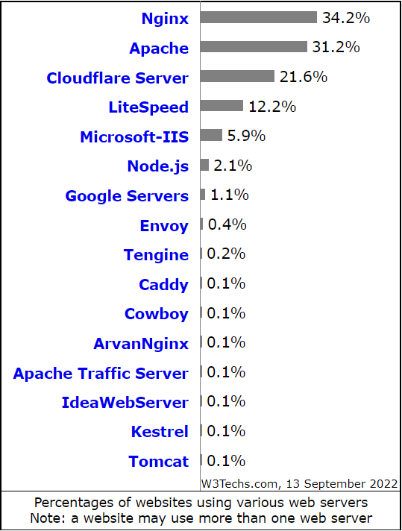
web server market
The following web servers are used by less than 0.1% of the websites
Gunicorn
Lighttpd
Oracle Servers
UploadServer
Zope
Resin
Undertow
Jetty
HCL Domino
Kangle
Hiawatha
WildFly
micro_httpd
WSGIserver
WEBrick
IceWarp
Waitress
vWebServer
Thin
Tornado
OpenBSD httpd
IBM Servers
……..
https://w3techs.com/technologies/overview/web_server/all

Slide 32
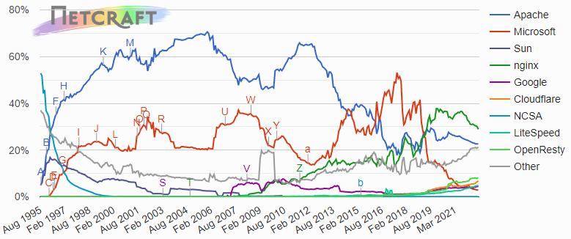
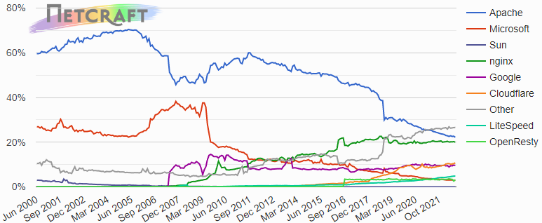
web server market
All sites
Active sites
https://news.netcraft.com/

Slide 33
Application Server
A program that handles all application operations between users and an organization's backend business applications or databases.
An extension of middleware solution
Introduced in order to isolate the business logic in projects
Facilitates multi-tier applications with flexible connections.
Data and code integrity
Centralized configuration
Security
Performance
Total Cost of Ownership (TCO)
Notes:
Distributed Transaction Processing (DTP)
Transaction Processing Monitors (TPM)

Slide 34
Web Application Server
Vendor | Access | Application Servers
Adobe | Commercial | ColdFusion, JRun
Apache | Free | Geronimo, Tomcat, TomEE
Apple | Commercial | WebObjects
Eclipse | Free | GlassFish, Jetty
IBM | Commercial | WebSphere, WebSphere AppServer (AS) Community
Fujitsu | Commercial | Interstage Application Server
Magic | Commercial | Magic xpa Application Platform
Microsoft | Commercial | IIS
Oracle | Commercial | Fusion Middleware, GlassFish, Oracle Containers J2EE, WebLogic
Red Hat | Free | JBoss Enterprise Application Platform, WildFly
VMware | Commercial | ThinApp
Notes:
Distributed Transaction Processing (DTP)
Transaction Processing Monitors (TPM)

Slide 35
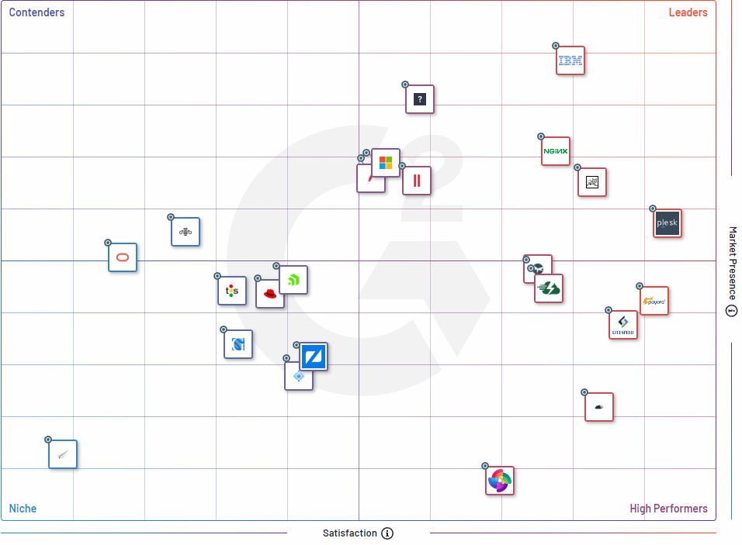
Web Application Server Market

